Slide 1
Secure Software Architecture

Slide 2
whoami
Linux sysadmin
Cyber Incident Responder
Digital Forensics Analyst
UNSW student of Richard Buckland
DoE employee for 13+ years

Slide 3
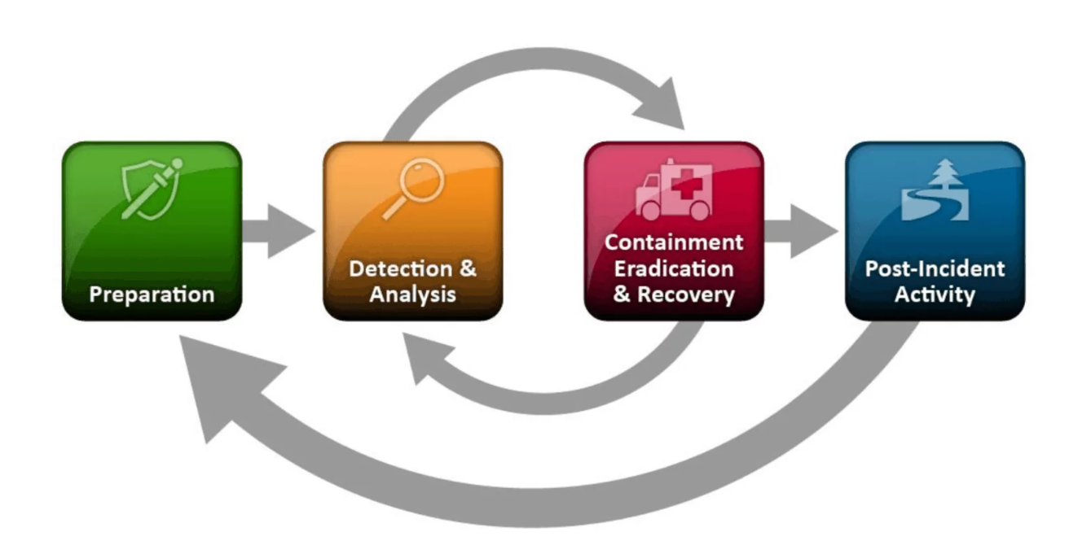
Incident Response

Slide 4
Security by Design
”Security should be baked into the system, not bolted on after the fact”

Slide 5
Core Principles
Confidentiality
Integrity
Availability
Least Privilege
Defense in Depth

Slide 6
Architecture Patterns
Zero Trust
Microservices / APIs
Threat modelling

Slide 7
Common Threats and Mitigations
OWASP top 10
Injection Attacks
Cross-site Scripting (XSS)
Broken Authentication

Slide 8
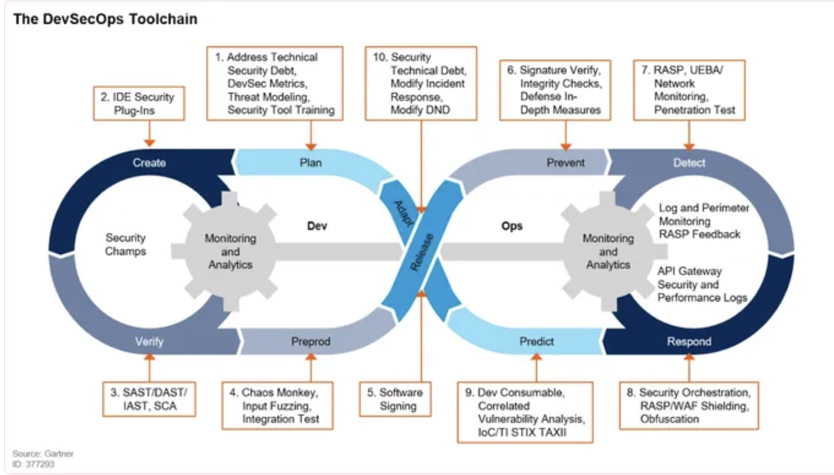
Development Cycle

